Slide 1
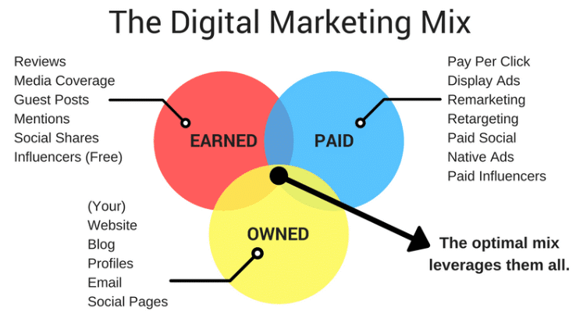
https://digivizer.com/blog/what-is-paid-owned-and-earned-media-the-marketing-mix/

